Slide 1

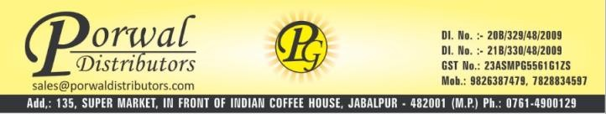
Porwal Distributors
We are a versatile channel partner who believes in creating enterprise around value adding products for lives and environment, sincerely aspiring to be the
Complete solution provider for super specialty medical devices in MP & CG region.
Acquiring leadership in supporting genuine & technology driven product portfolios.
.

Slide 2
We are….
An young , growing and dynamic proprietary firm established in the year 2009.
Evolving as one of the most promising channel partner firm with leading multinational organizations to support their businesses in emerging markets.
Last year’s annual turnover was 10 MN INR with three years CAGR of 50%.
Current year target is 15cr.

Slide 3
Our key strengths……
PD is being run by team of professionals.
We are well established name for corporate and other esteemed hospitals of MP & CG.
We have been appreciated for our supply chain capability and customer relations by Global devices companies in the form of appreciation, enhancing territories and adding new divisions.
We have offices at Indore, Bhopal, Gwalior & Jabalpur.

Slide 4
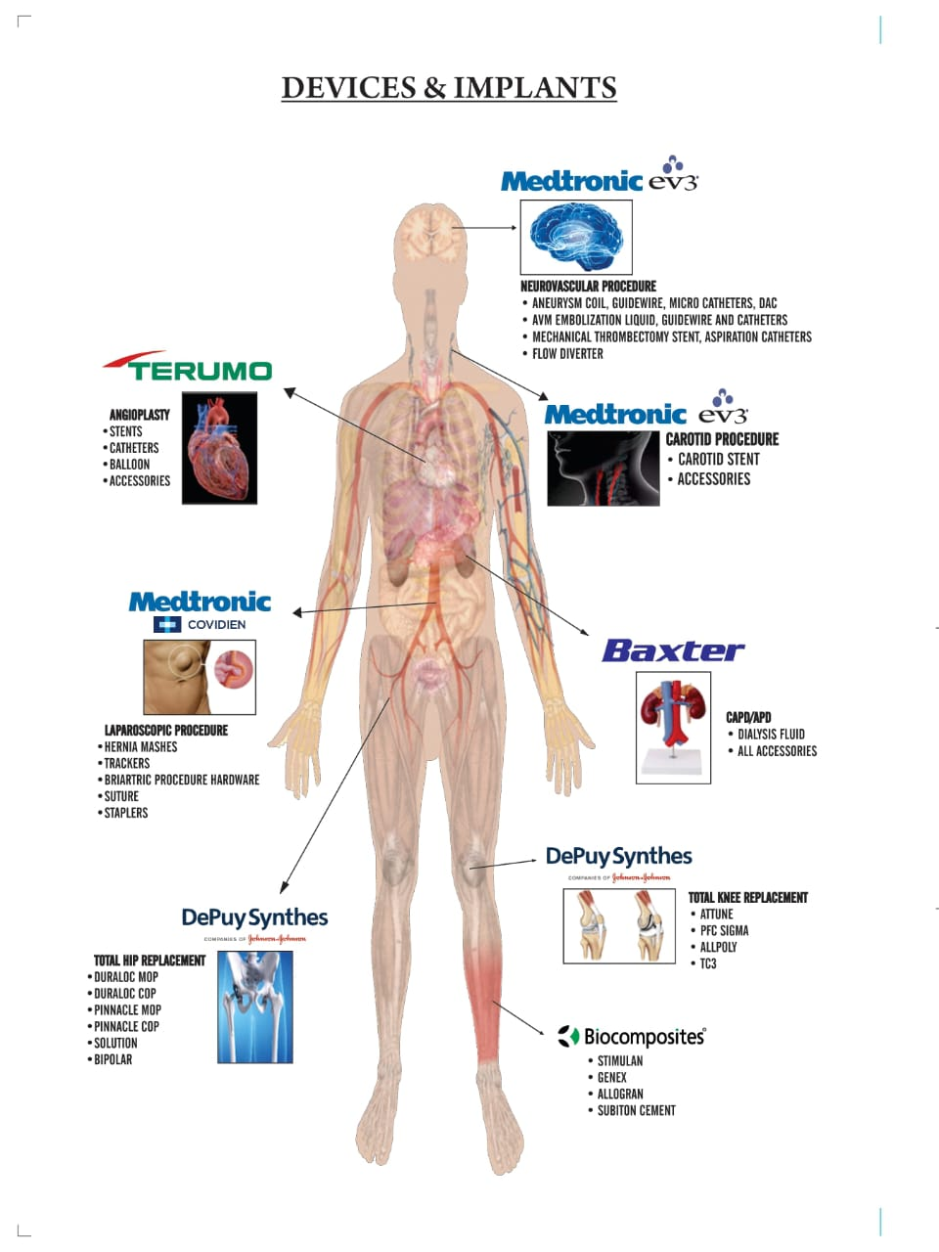

Slide 5
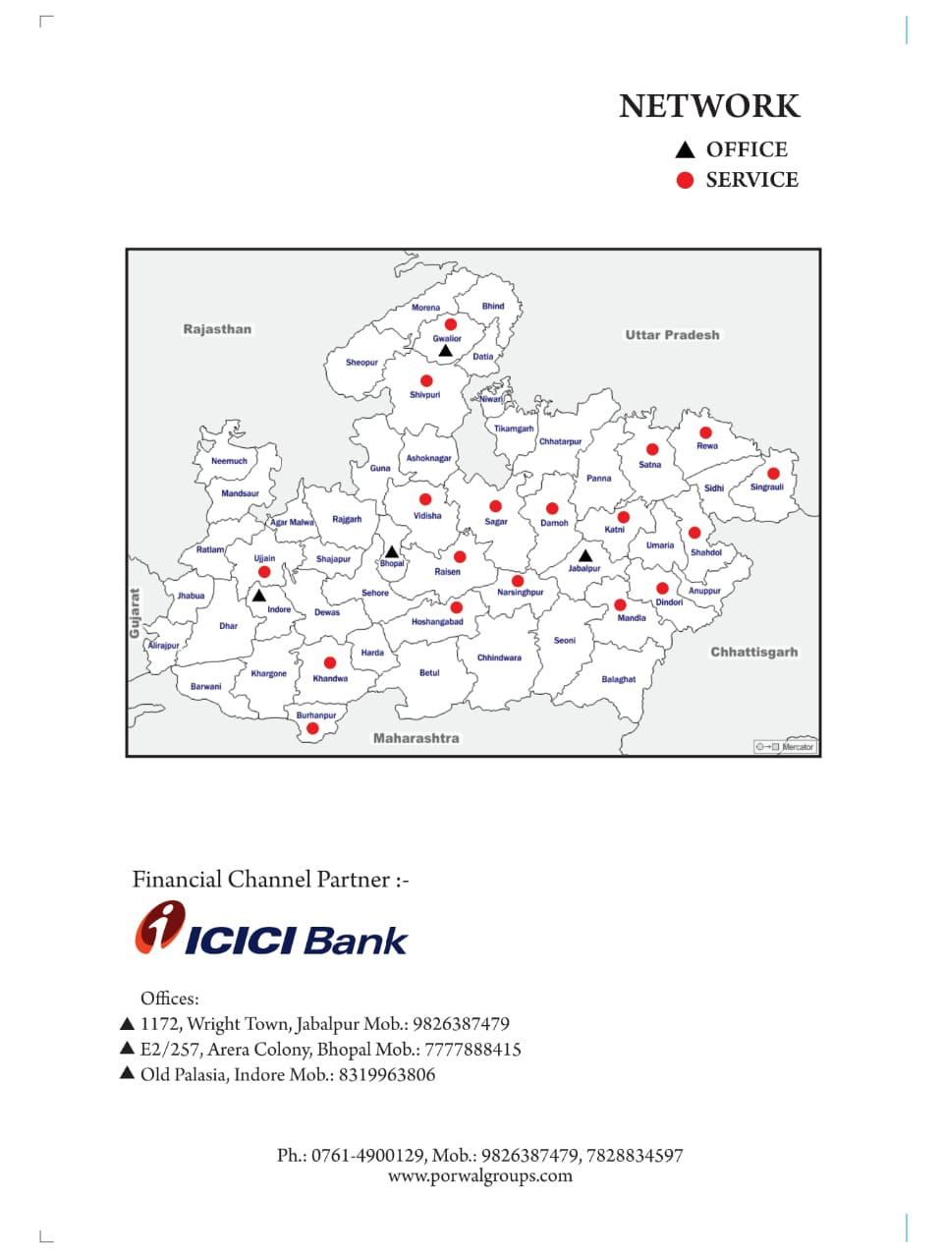

Slide 6
Revenue last five years
CAGR ~ 50%

Slide 7
Org Structure
Mrs. Arti Gupta
Post graduate and vast experience in Radiology
Amit Gupta
(Ex. VP – Supply Chain Dominos India)
Engineering graduate having extensive experience with global Pharma & FMCG organizations
Ankit Gupta (Ex Cadila)
MBA having 13 years of entrepreneurial Experience
Business Dev. Mgr.
BDM – Bhopal, Gwalior
BDM - Indore
Executive – back Office
Accountant
Supply chain team
Technicians

Slide 8
Other ventures………..
We are authorized dealer of SURMOUNT pharmaceuticals for entire Mahakaushal region.
We have launched our own brand as “LAXODITE” in Herbal laxative powder category

